Slide 1
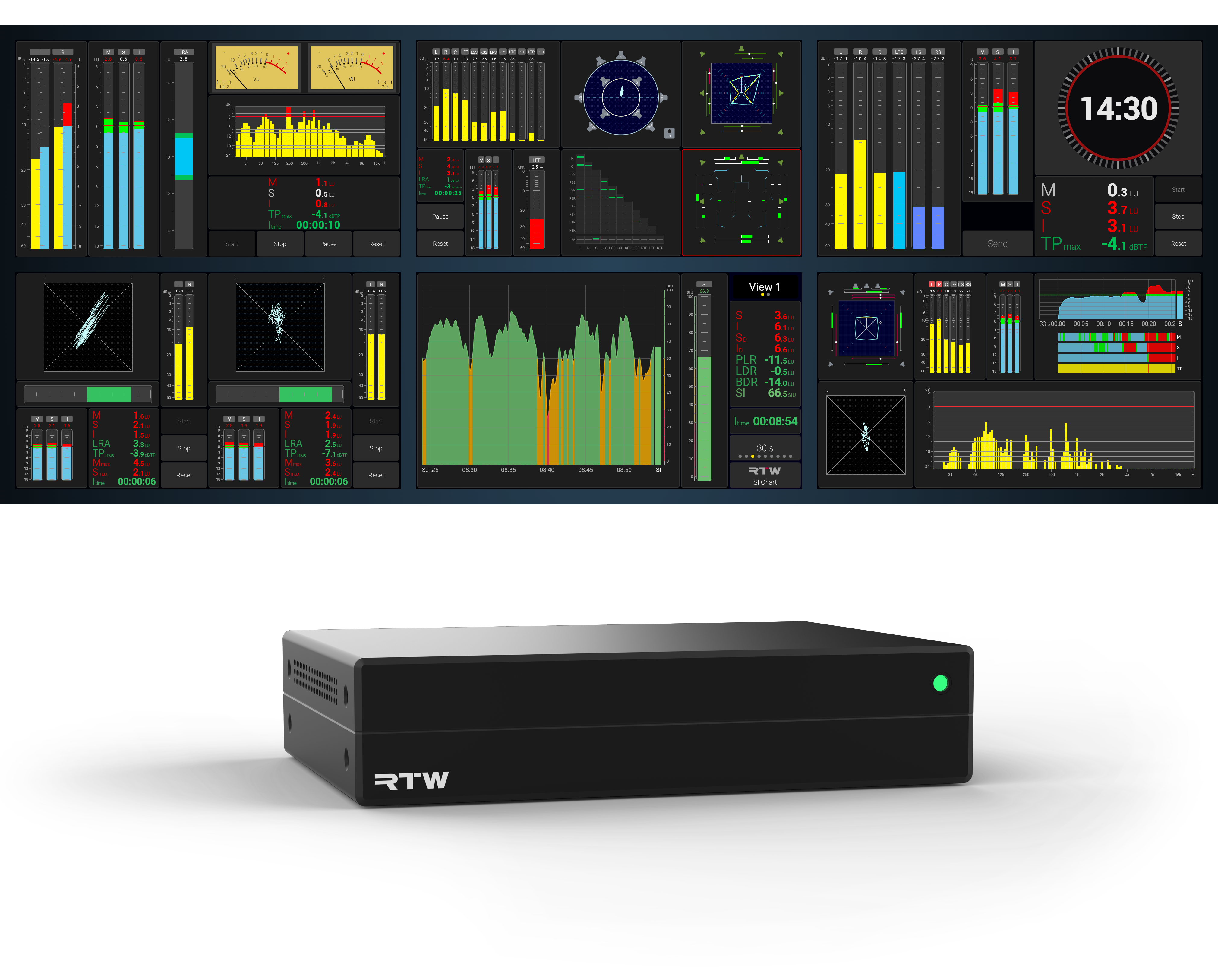
TMxCore
Immersive. Dialog Intelligent. Compliant

Slide 2
Background
What is it?
RTW’s latest high-end, high-performance broadcast and pro audio metering platform
AI-assisted tools for advanced dialog intelligibility analysis
Immersive audio metering for 5.1 surround and 7.1.4 formats - and beyond
Fully compliant suite of loudness and metering instruments
Network display: view your meters in any browser, anywhere
DisplayPort output for direct connection to any monitor - up to 4K: 3840 × 2160
Network-ready with RAVENNA®, AES67, ST 2110, Dante®, and traditional I/O options
Designed for modern workflows

Slide 3
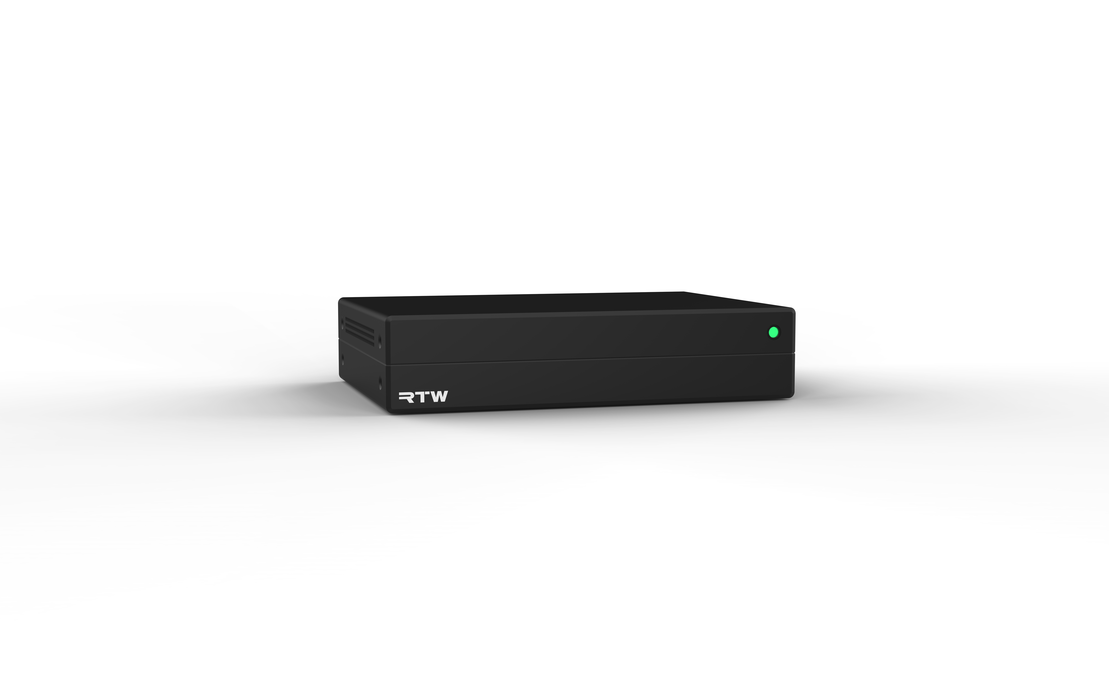
User Configurable 5” Touch Display

Slide 4
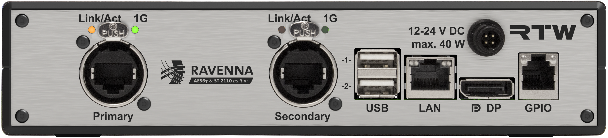
USB for touchscreen, mouse/keyboard, harddrive
User Configurable 5” Touch Display
Audio Over IP / Traditional Digital or Analog I/O
LAN connection for network display, control, OSC
DisplayPort for external display (4K: 3840 × 2160)
GPIO for external control

Slide 5
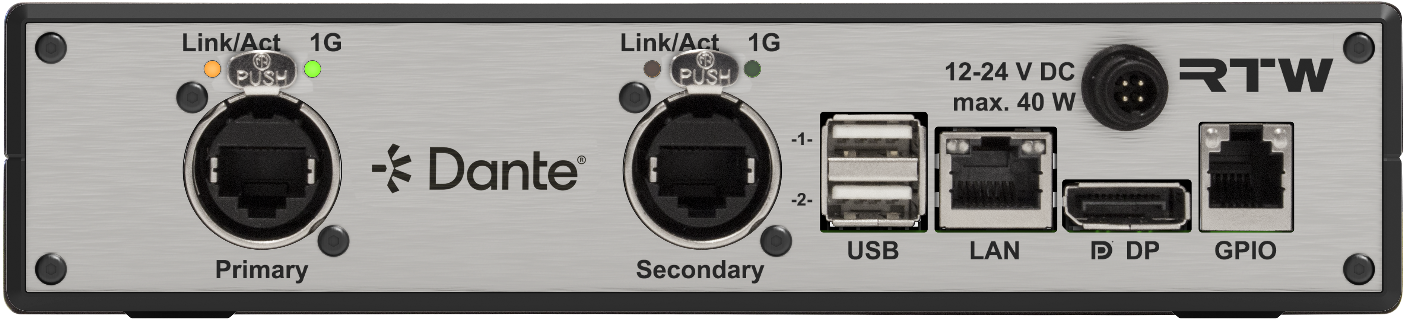
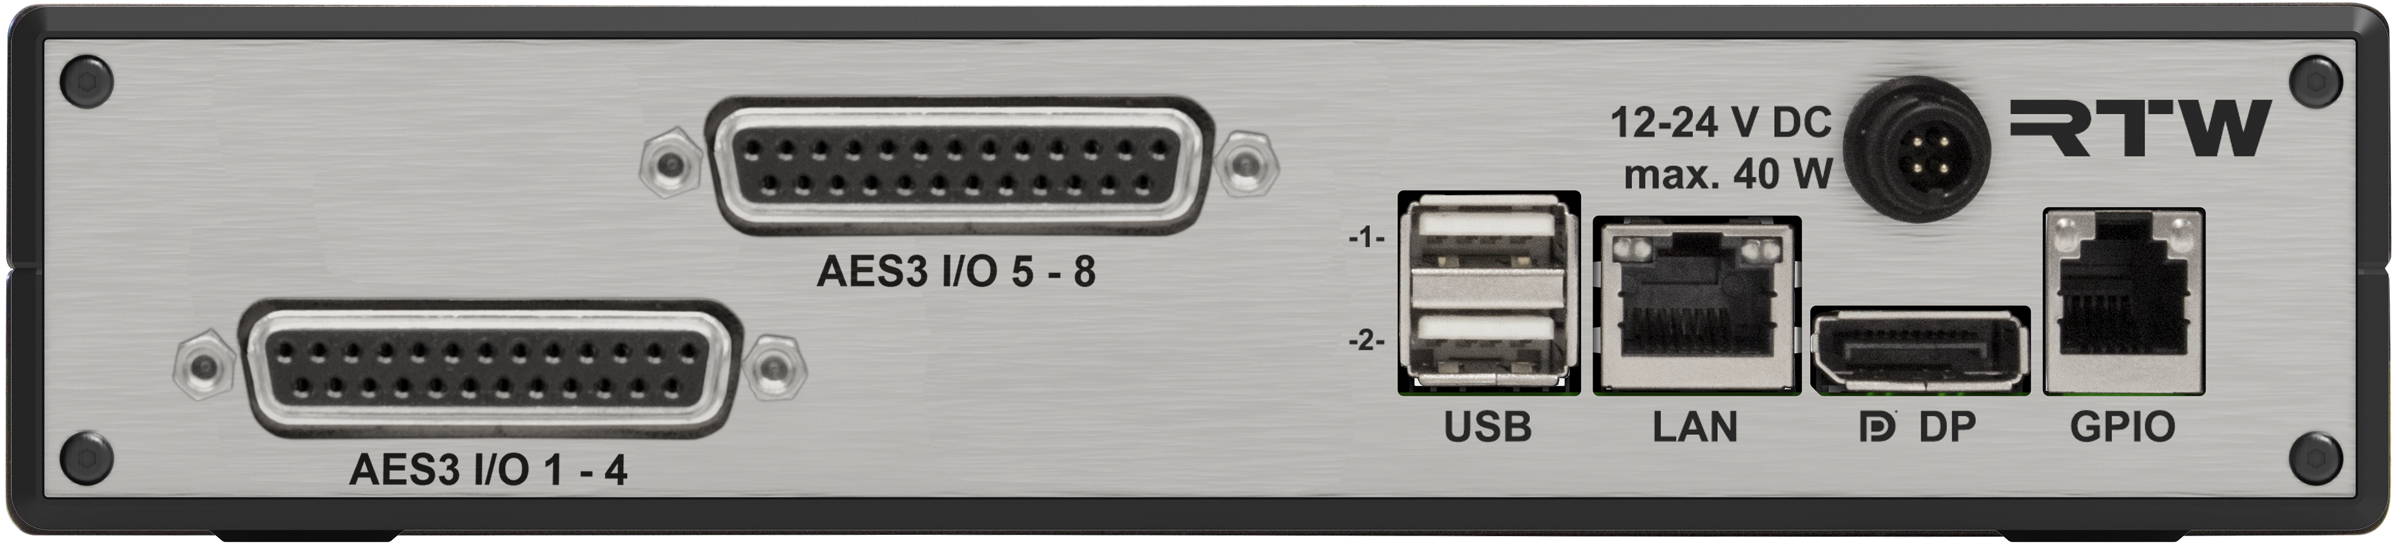
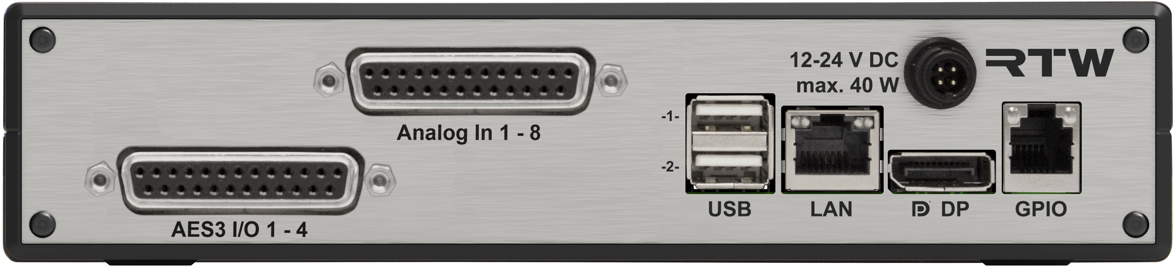
Features
I/O: Four Options
USB, GPIO, LAN Control, DisplayPort
RAVENNA ST2110/AES67 NMOS
32 Channels
DANTE
32 channels
AES16
16 channels sub-D 25
AES8 + Analog8
16 channels sub-D 25

Slide 6
Title
Instruments
The most comprehensive metering engine ever from RTW

Slide 7
Features
The instruments you know
Reliable, Classic
Built on the trusted TouchMontior TM7/TM9
Levels, frequency, loudness compliance, phase issue detection

Slide 8
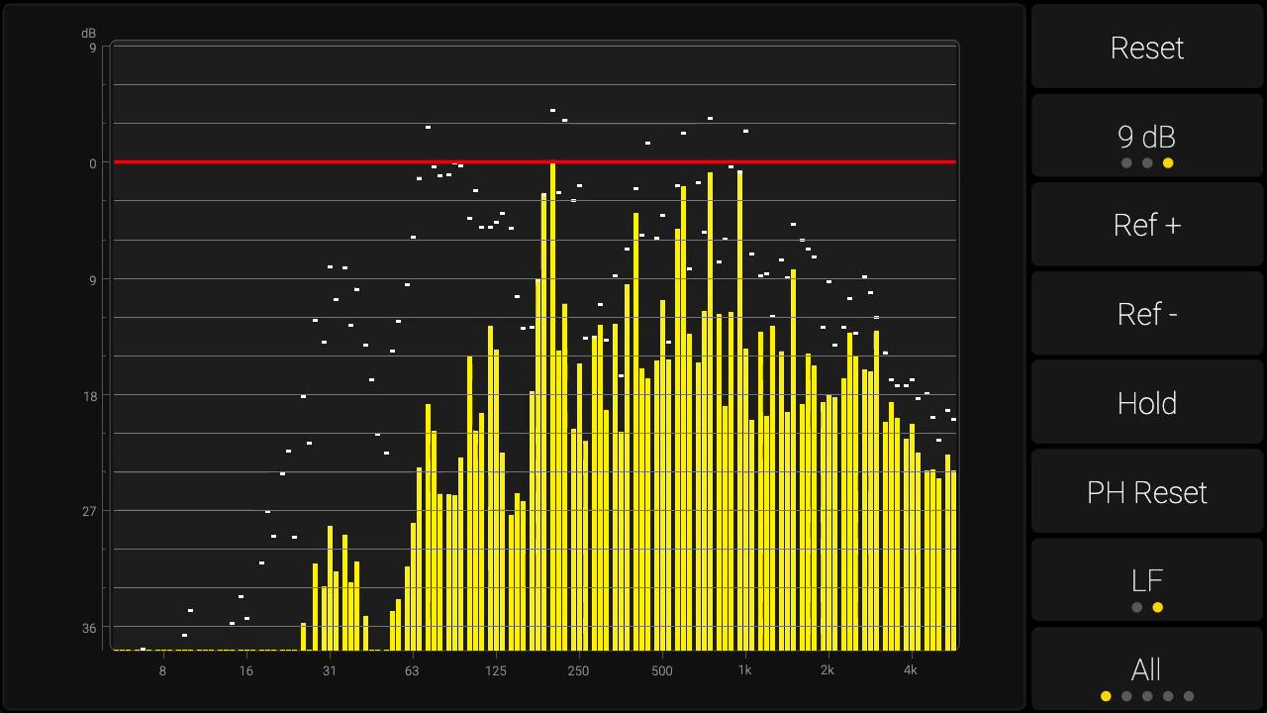
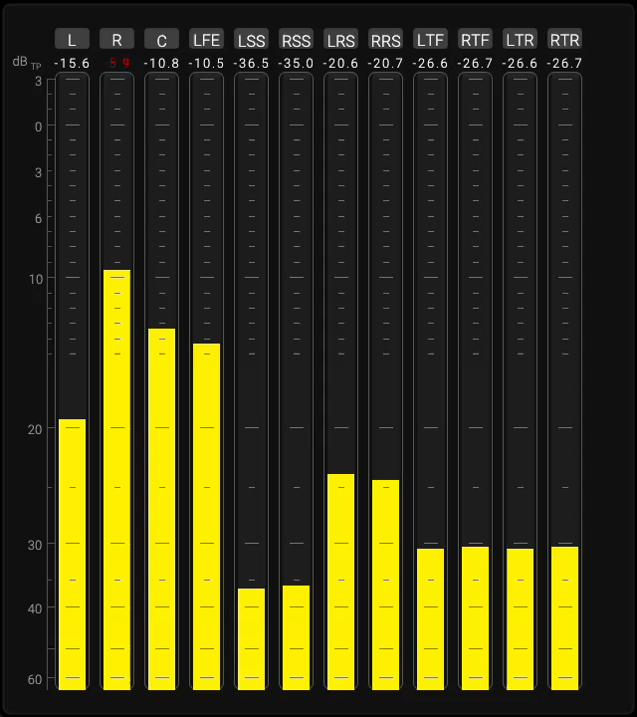
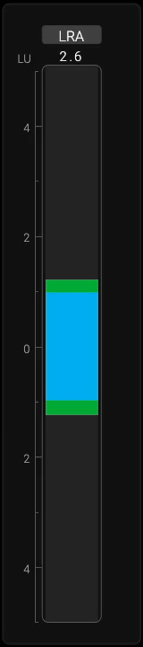

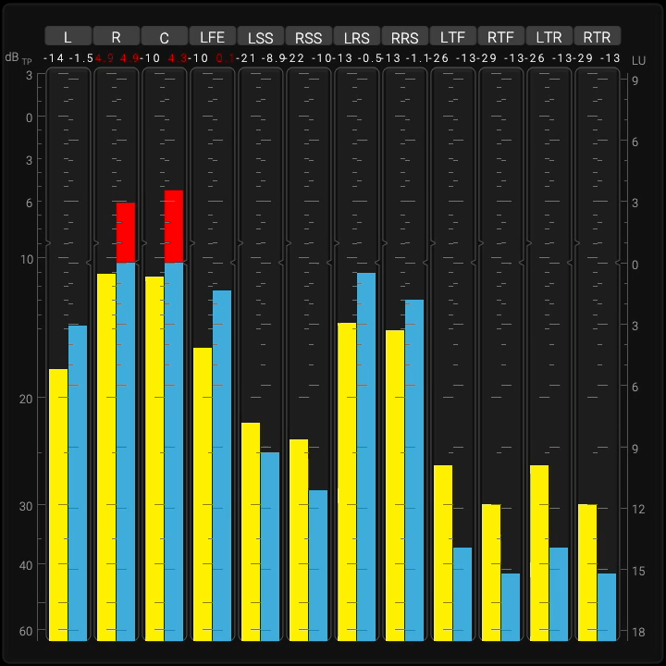
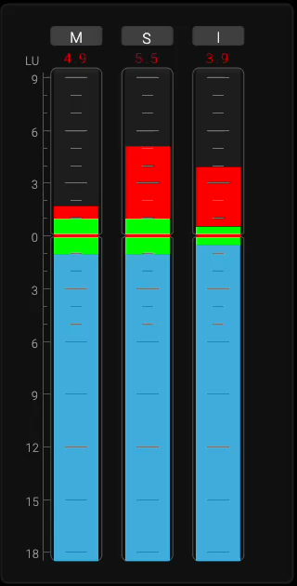
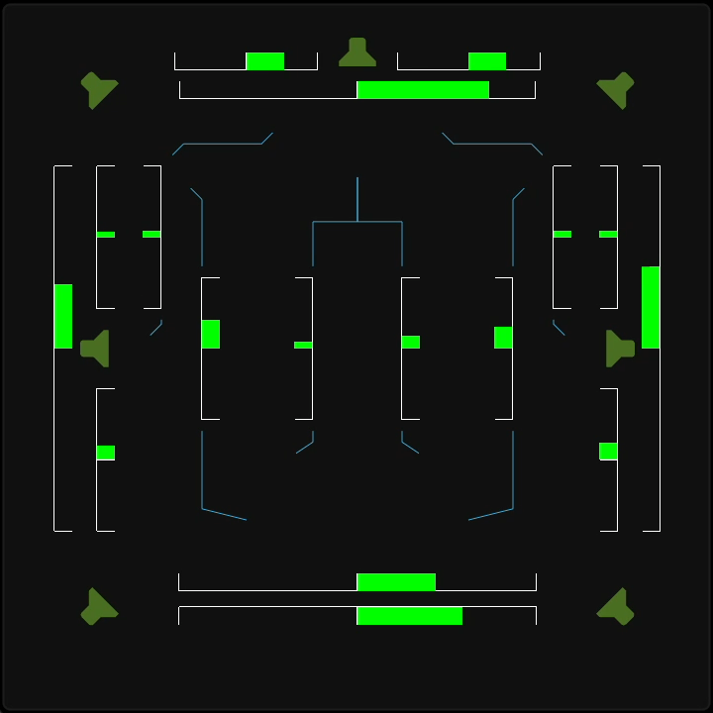
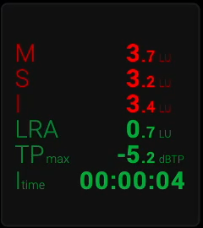
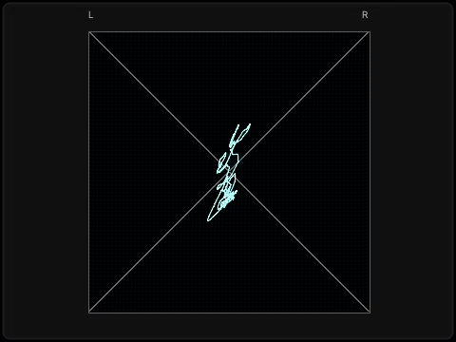
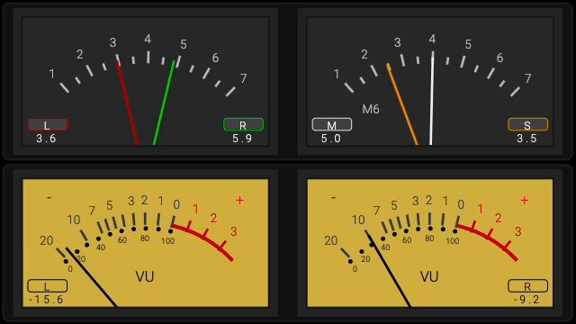
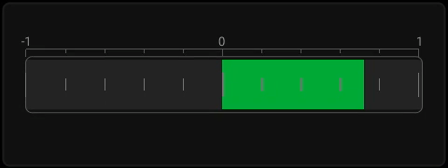

Slide 9
Features
Immersive Metering
Surround and Immersive formats. 5.1, 7.1.4 Atmos - and beyond
Commonly used by broadcasters around the world
Spatial Balance, Relationship between multiple speakers, detect phase issues
Correlation problems with LFE channels

Slide 10
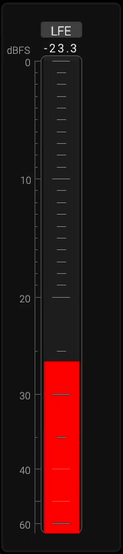
NEW
Features
New: LFE Bleed
Avoid high frequency content in your LFE Channel
Monitors energy above a defined threshold (120 Hz by default) with a compact dBFS bargraph, highlighting any leakage into the LFE channel(s).
Recommends limiting the LFE frequency range to maintain compatibility and avoid distribution problems.
Ensures that unwanted high-frequency content is not present in the LFE channel(s), preventing playback issues across encoders and binaural formats.

Slide 11
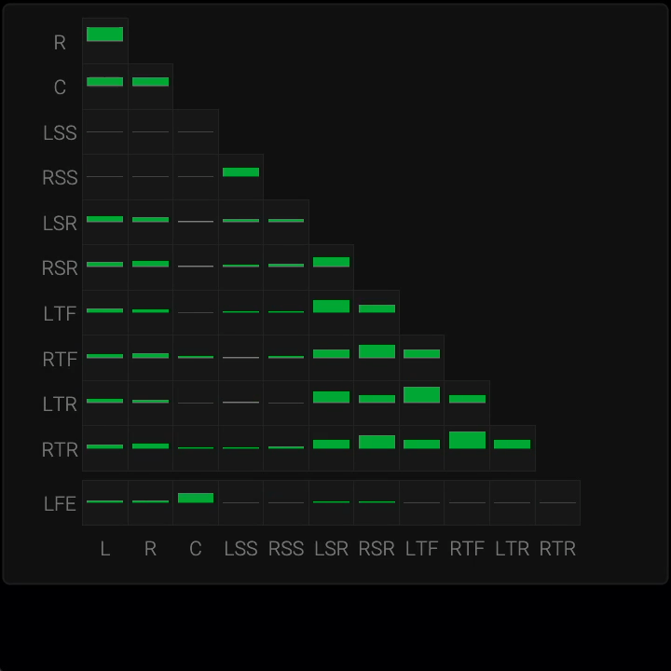
NEW
Features
New: The Matrix Correlator
Detect phase issues in a complex channel setup
Displays detailed phase relationships between all channels, from simple stereo up to complex 30.2 formats
Provides a comprehensive overview of inter-channel correlations for precise monitoring
Enables fast detection of phase conflicts within a mix, ensuring accuracy and consistency across formats

Slide 12
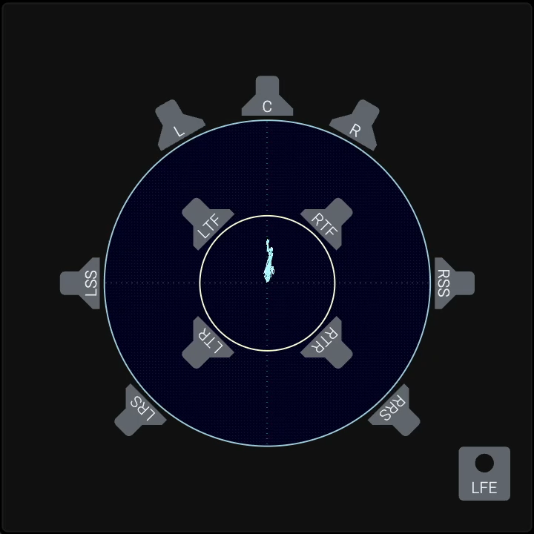
NEW
Features
New: The Polar Scope
Watch spatial coherence, channel delay mismatches
Extends the principle of the classic stereo vectorscope to surround and immersive formats, visualizing inter-channel correlations as geometric patterns.
Represents each loudspeaker as a vector in a spatially aware coordinate system, providing real-time insight into spatial image width, depth, and energy distribution.
Reveals issues such as channel delay mismatches, phase conflicts, or front/rear imbalances, while confirming overall spatial coherence of the mix.

Slide 13
Title
Dialog Intelligibility
Hottest topic in Broadcast

Slide 14
Features
Dialog Intelligibility
The most critical challenge in dialog sound today
Severe issues reported by end listeners
Multiple, often conflicting, approaches to measuring the problem
Gathering insights and recommendations for the Loudness Blog
Driving efforts toward a unified industry standard

Slide 15
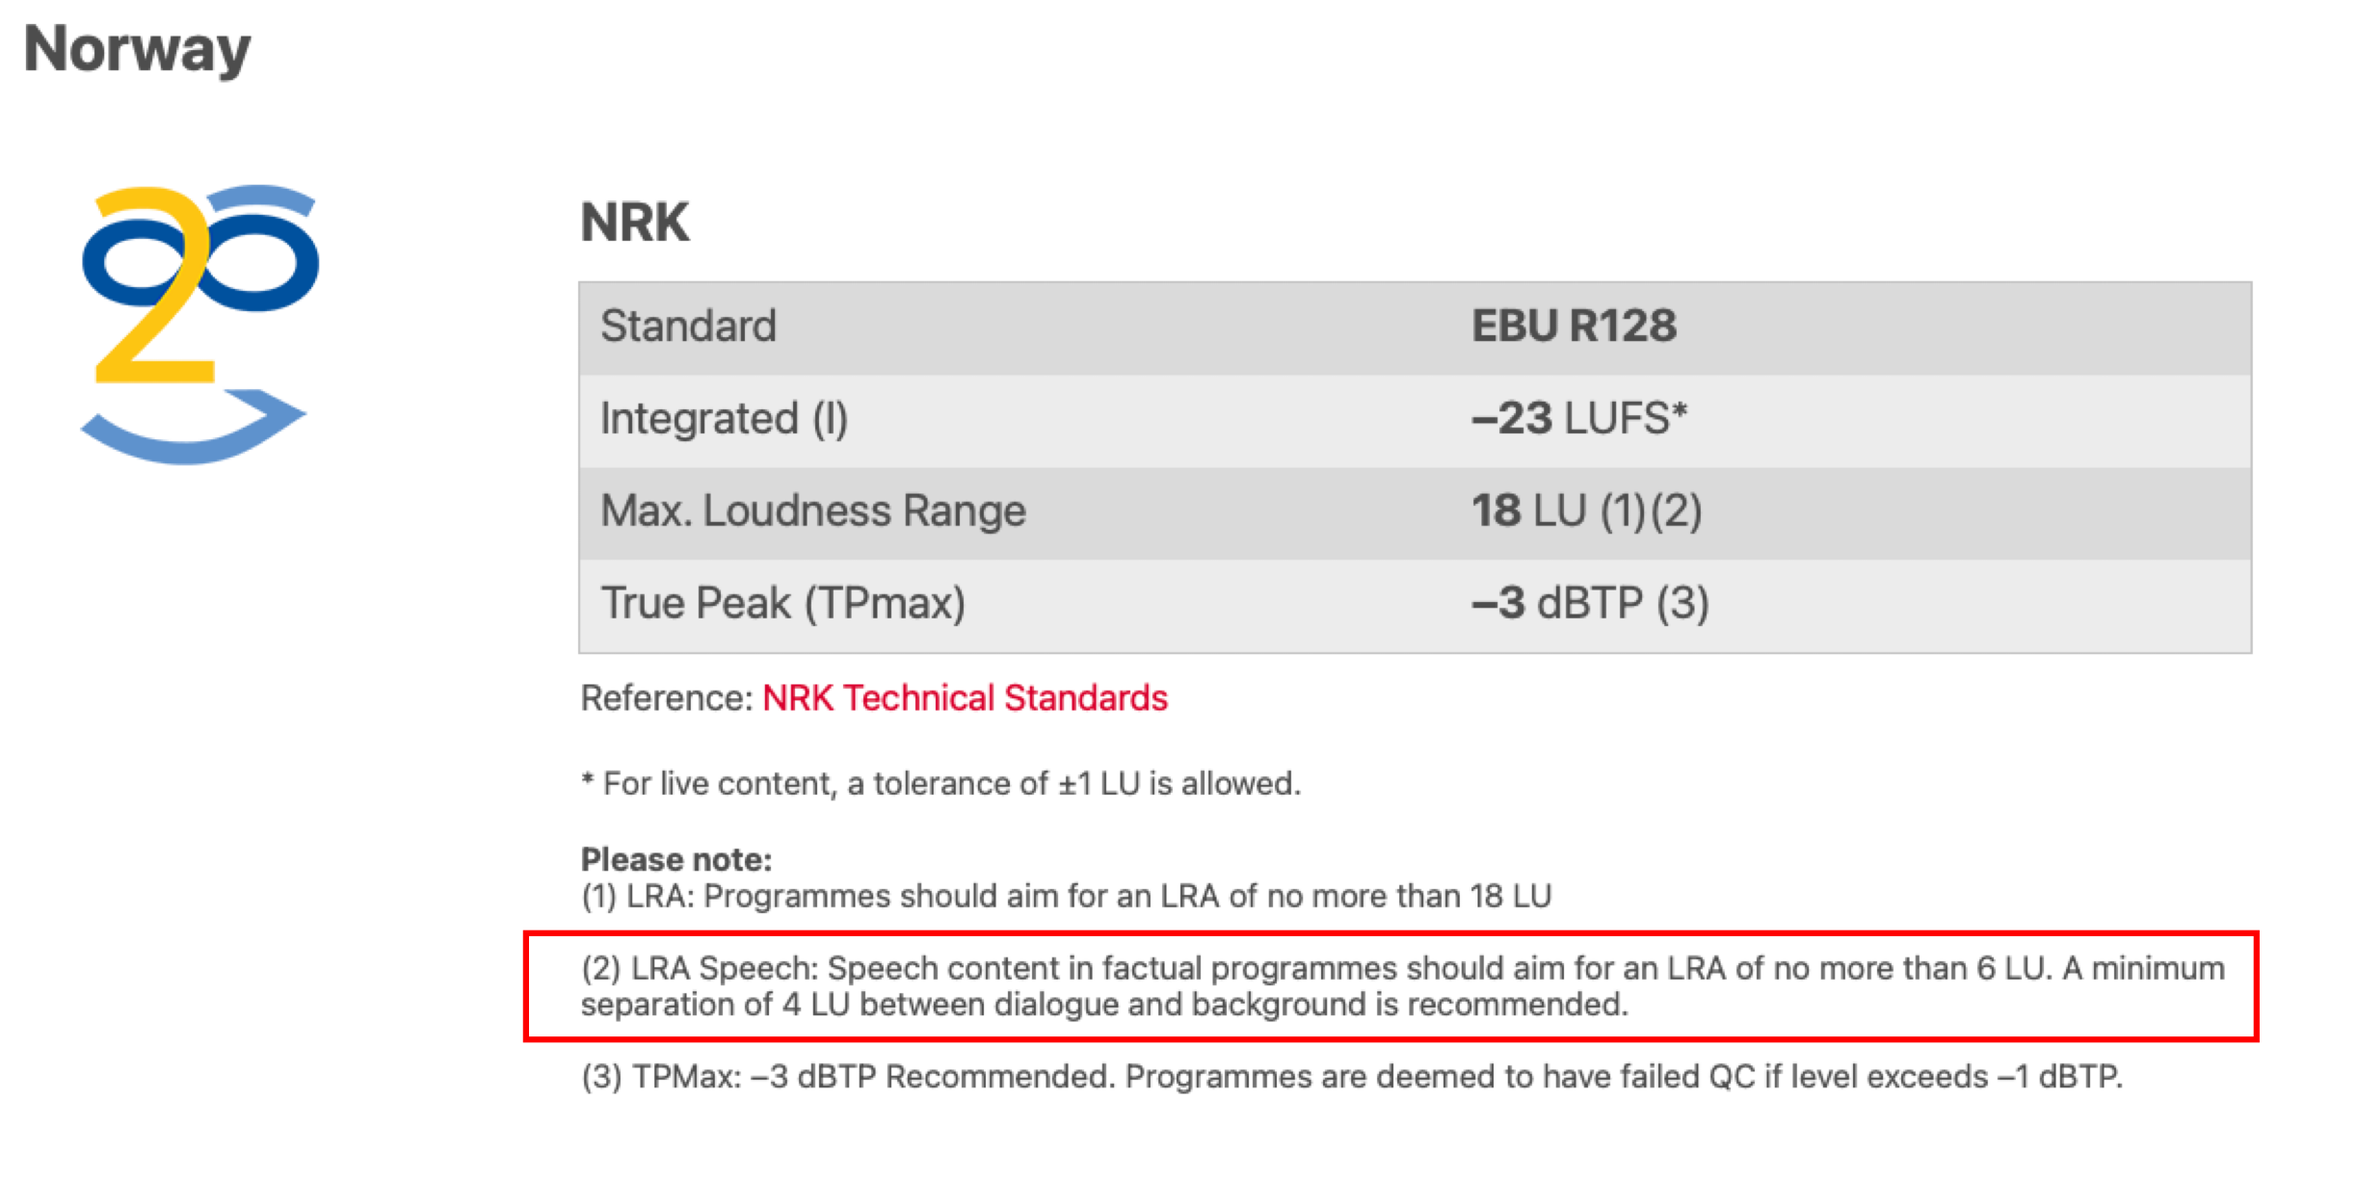
Features
Dialog Intelligibility:
Loudness Based Approach
Dolby Dialog Intelligence: Dialog Gated Loudness Measurement (Netflix)
LDR: Loudness-to-Dialog Ratio. Specified in EBU R128 Supplement 4.
BDR: Background-to-Dialog Ratio. Ratio between the dialog and background audio. NRK (Norway), BBC, ARD, W3C and others.

Slide 16
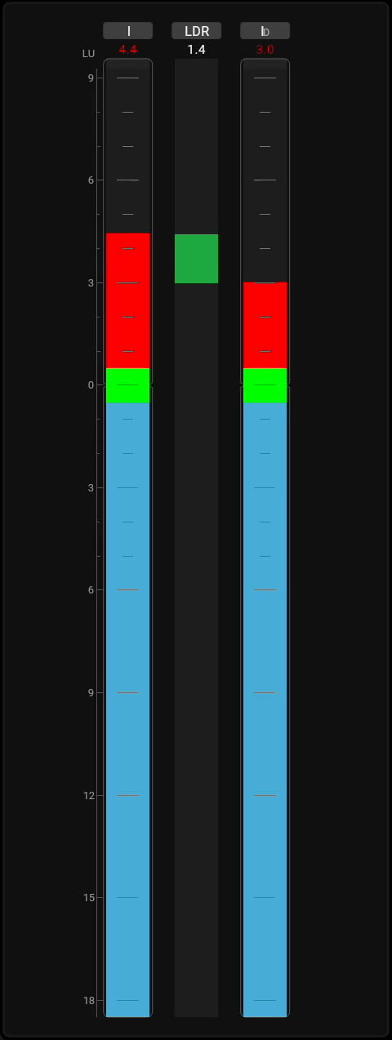
NEW
Features
New: The Ratio Instrument
Keep an Eye on the Dialog Ratio
Displays the ratio between two measurements, enabling precise evaluation of ratio and consistency.
Supports key use cases such as Loudness-to-Dialog Ratio (LDR) and Background-to-Dialog Ratio (BDR) within a single source.
Compares loudness across different sources or renderings (e.g., pre/post processing, immersive vs stereo), revealing the impact of processing and format changes

Slide 17
NEW
Features
The Dialog Intelligibility Instrument
Eyes on Dialog Intelligibility
Provides AI-driven, objective measurement of dialogue clarity, developed in cooperation with Fraunhofer IDMT and based on over nine years of research.
Delivers real-time visual feedback that helps engineers balance dialogue, effects, music, and background noise with confidence.
Available as a license option for TMxCore, giving broadcasters and audio professionals a proven solution for consistent dialog intelligibility across formats.

Slide 18
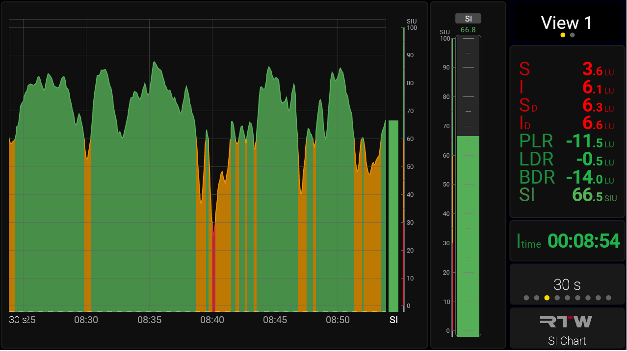
NEW

Slide 19
NEW
Features
Action Instrument & OSC
Support for Open Sound Control
Create customizable buttons with user-defined size, position, and color.
Trigger actions via Open Sound Control (OSC over TCP/UDP) or HTTP.
Two-way OSC: TMxCore also reacts to incoming commands such as preset recall, loudness control, reference level, and mic gain.
Actions is integrated in current buttons (Mute, Dim, etc.), too

Slide 20
NEW
Features
Wall Clock
Eyes on the Clock
Provides an always-on wall-clock reference in a broadcaster-friendly design
Offers four styles: digital, analog modern (no numbers), analog classic (with numbers), and broadcast focus with a red seconds ring
Support for Offset (Time Zones)
Ensures maximum readability and flexibility, integrating accurate time display directly into the monitoring workflow

Slide 21
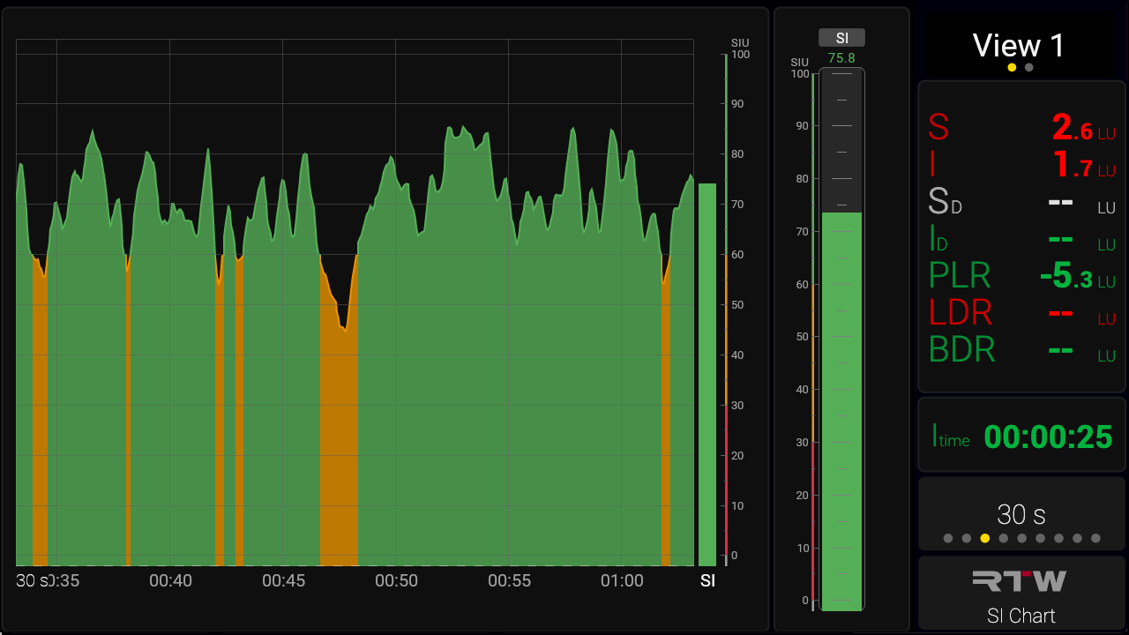
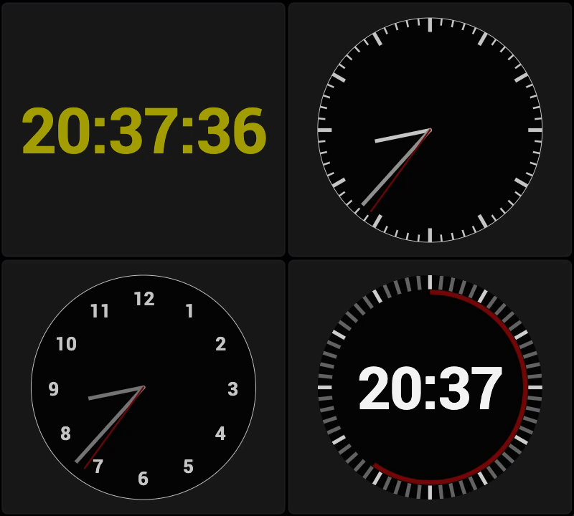
NEW
Matrix Correlator
Polar Scope
Ratio
LFE Bleed
Dialog Intelligibility
Clock
Action: OSC

Slide 22
Features
Delay Compensation
Advanced dialog-gated loudness and dialog intelligibility measurements may add up to 2 seconds of latency, required for reliable detection
RTW’s metering engine features built-in delay compensation to keep all meters visually aligned
Audio outputs (new) remain time-aligned, ensuring playback corresponds precisely with the display
Good for comparison

Slide 23
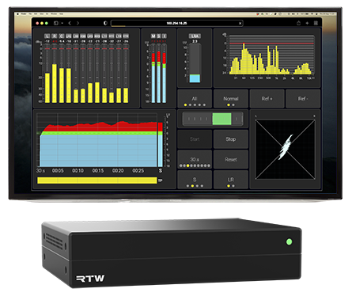
Features
Network Display
Eyes on your Audio from Everywhere
View real-time audio measurements anywhere on the local network using a standard web browser, without extra hardware
“Local network” = any location on the planet with a VPN connection
Monitor flexibly from control rooms, production suites, or multiple workstations
Expand with additional licenses, each adding a new metering instance (screen) to your setup
Latency: 1 frame (20ms) plus network latency

Slide 24

Features
Rack Mount Kit

Slide 25
Title
Customers & Applications
Who will benefit from TMxCore?

Slide 26
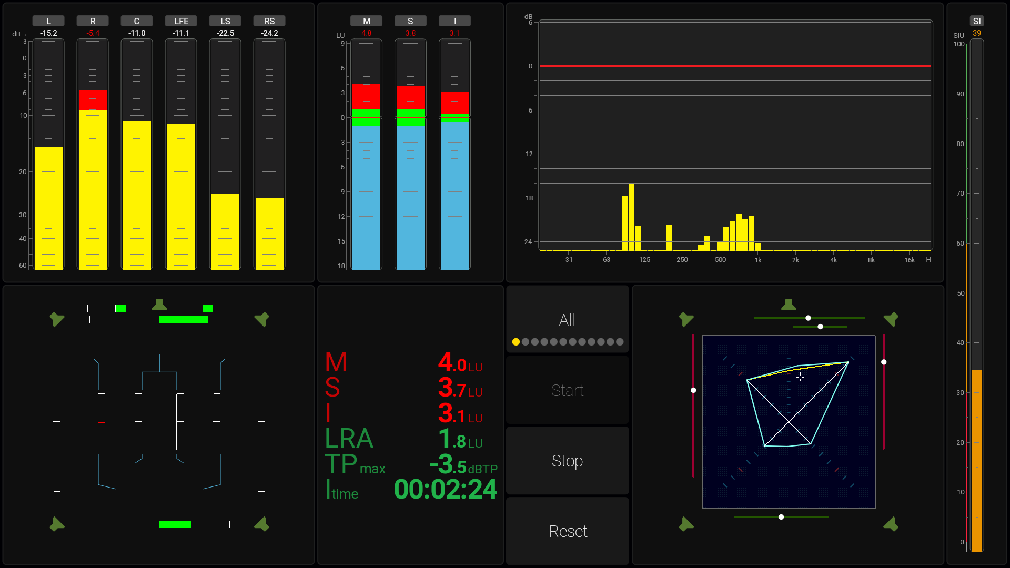
Applications
Broadcast: Live Sports, Music, News
Versatile connectivity: Supports Ravenna, AES67, and ST2110 networks for seamless integration in modern broadcast environments.
Comprehensive monitoring: Equipped with robust loudness tools to handle live broadcasts from sports and music to news.
Trusted compliance: Ensures adherence to international loudness standards, delivering consistent, high-quality audio.

Slide 27
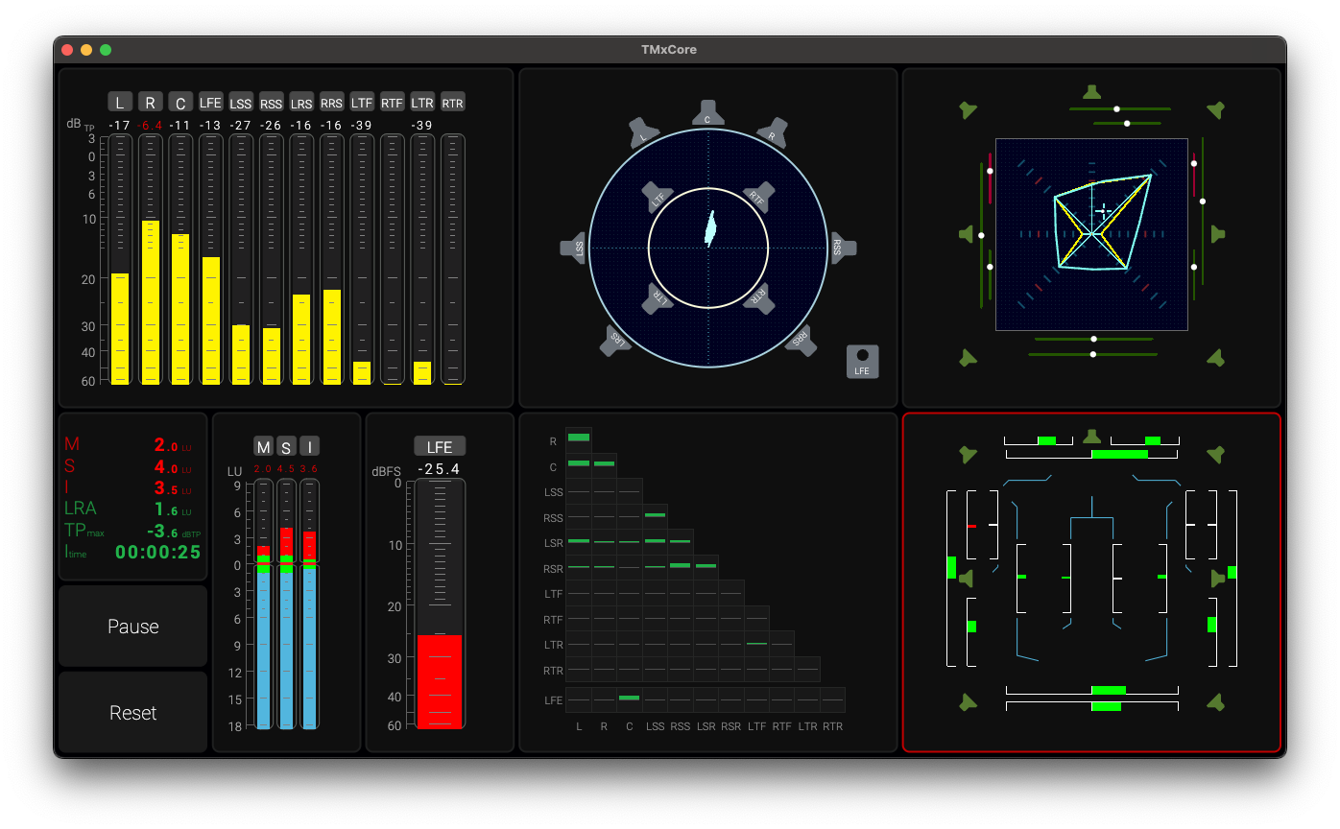
Applications
Post Production and Cinema
Immersive-ready: Advanced metering tools tailored for immersive audio and dialog intelligibility on Dante® audio networks.
Standards compliance: Simplifies adherence to international loudness regulations such as EBU R128 and ATSC A/85 (CALM).
Delivery assurance: Meets streaming platform requirements, including specifications from Netflix.

Slide 28
Applications
Installed Sound
AoIP integration: Designed for installations in stadiums, theaters, houses of worship, and event spaces.
Comprehensive toolkit: Provides a full suite of metering instruments for professional audio monitoring.
Audience focus: Empowers engineers to optimize performance and deliver an enhanced listening experience.

Slide 29
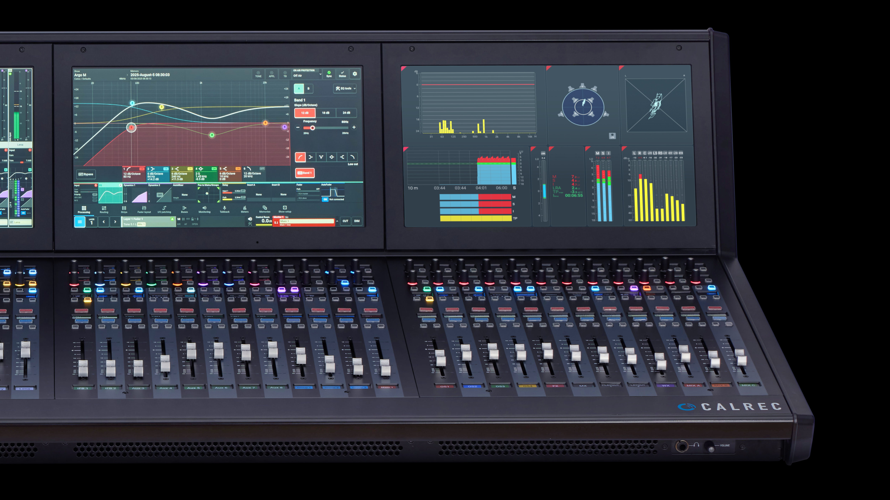
Applications
OEM: Broadcast Consoles
Screenless flexibility: A compact, display-independent platform that integrates seamlessly while leaving full visual control to console manufacturers.
Future-ready performance: Equipped with powerful CPU and RAM resources to handle loudness, dialog intelligibility, and immersive audio standards.
Trusted integration: Standardized I/O, network connectivity, scalable licensing, and RTW’s proven quality ensure reliability without compromise.

Slide 30
Market
Licenses
Super simple licensing structure
Basic version contains what most need
Three licenses: Immersive, Dialog Intelligibility, Extra Screen Displays
Pricing equals that of a classic TM with relevant tools

Slide 31
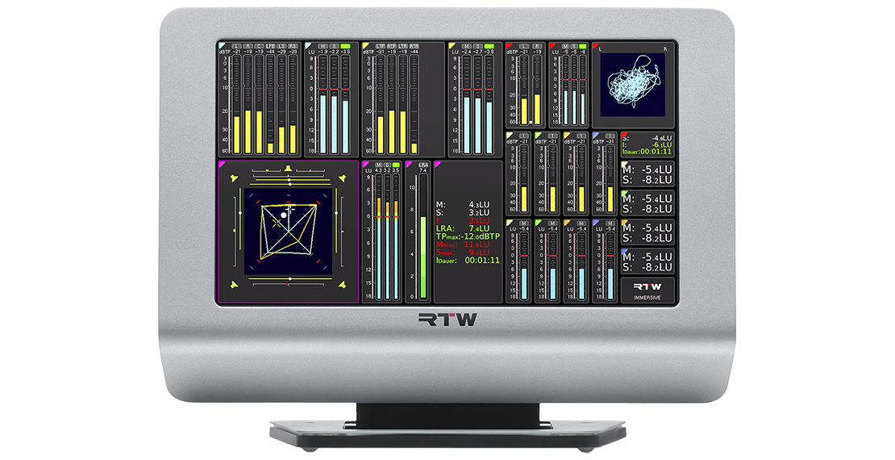
Status
Classic TouchMonitor TM7/TM9?
Still Available
All versions
Including OEM Versions

Slide 32

Read More
Product Page
TMxCore Product Page

